Slide 1
Computational Studies of Perylene Diimide (PDI) and Dibenzoporphyrins

Slide 2
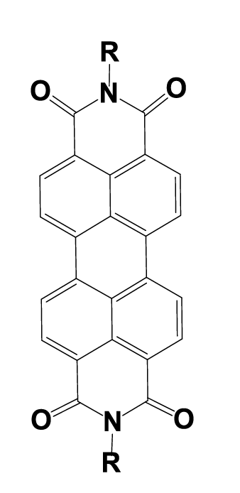
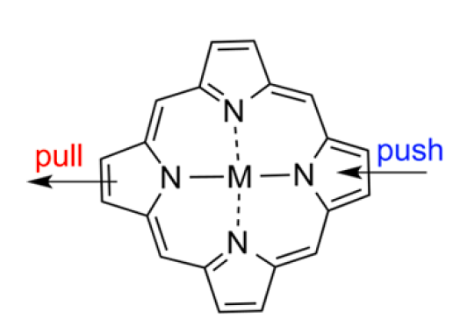
Outline
Perylene Diimide
(Pingmei Wang and Dan Glatzhofer)
β-functionalized porphyrins
(Hong Wang, UNT)

Slide 3
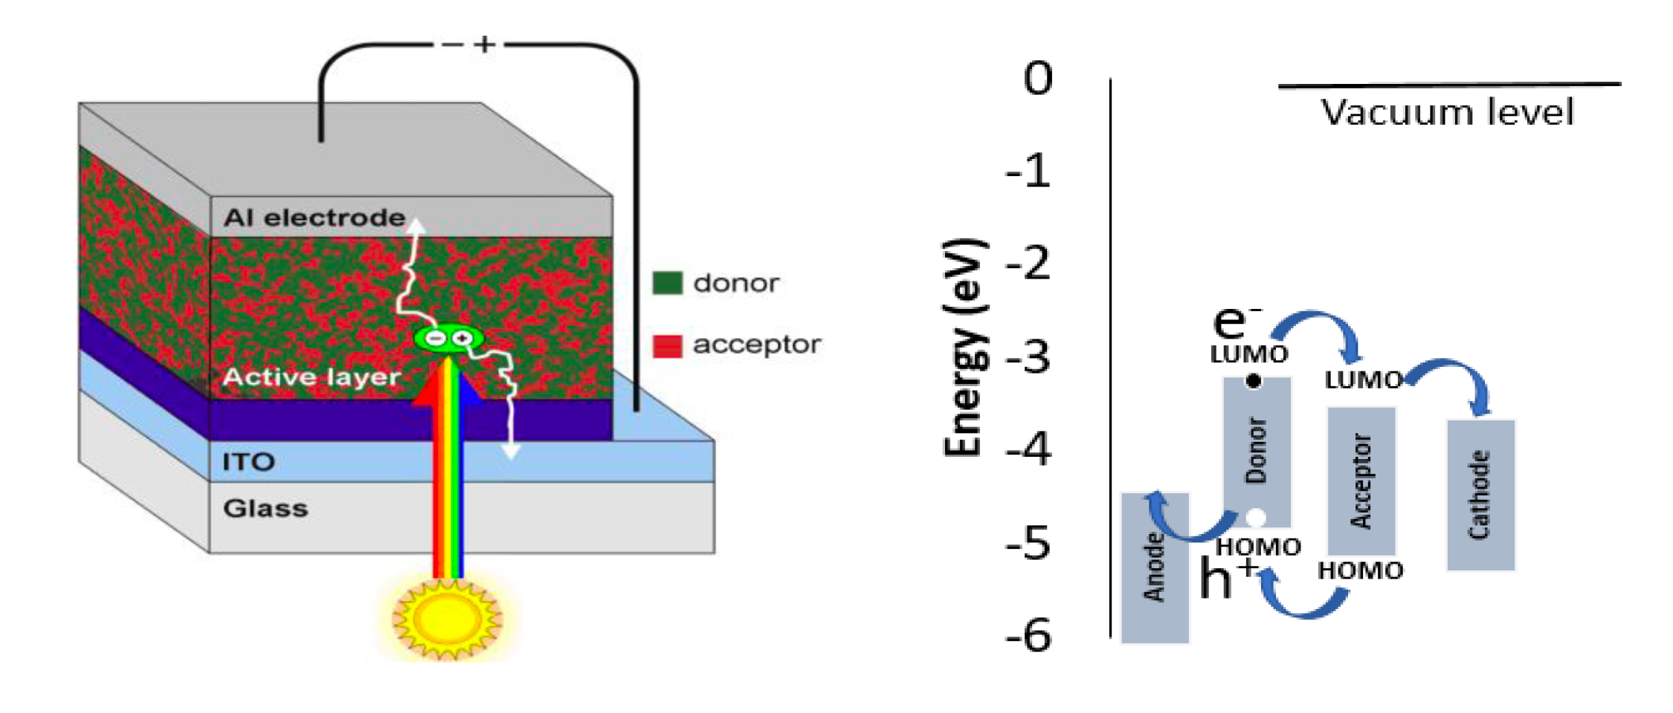
Organic Solar Cells

Slide 4
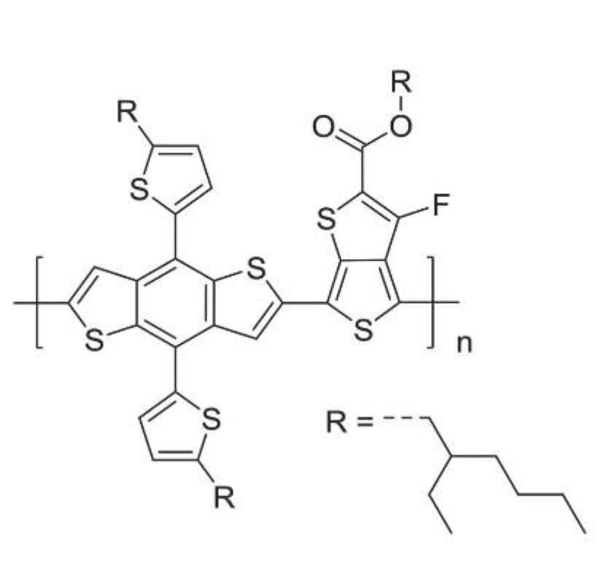
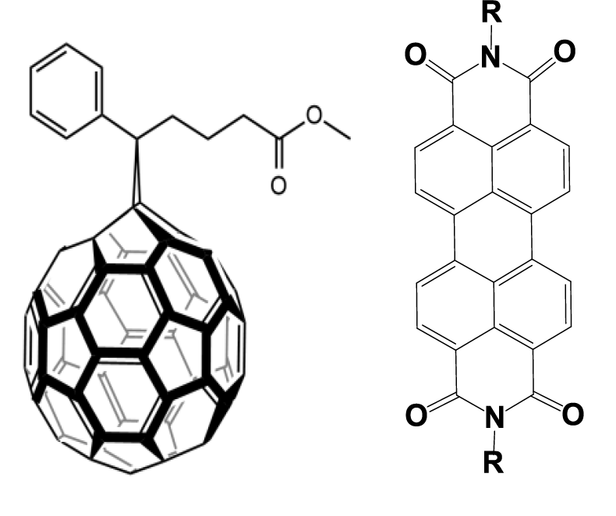
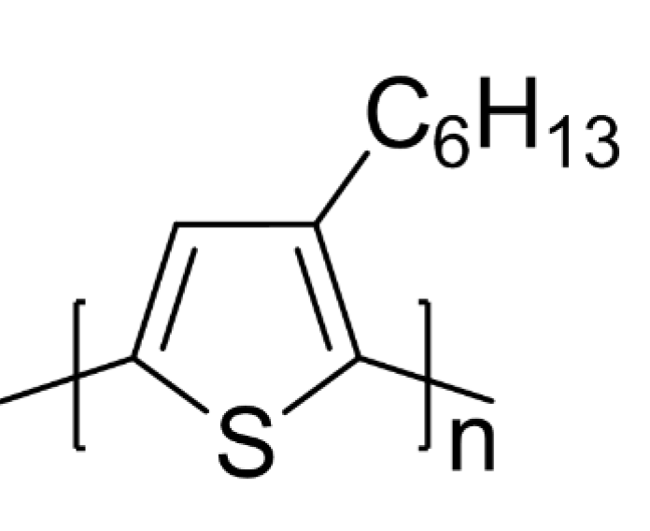
Donors and Acceptors
P3HT
PBDTT-F-TT
PC₆₁BM
PDI

Slide 5
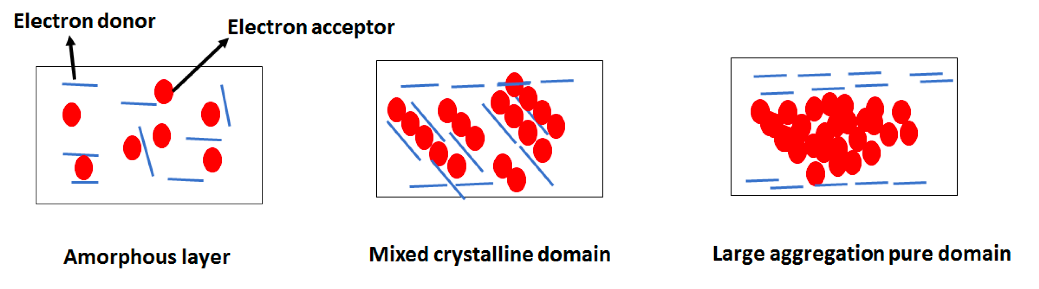
Photoactive Layer

Slide 6
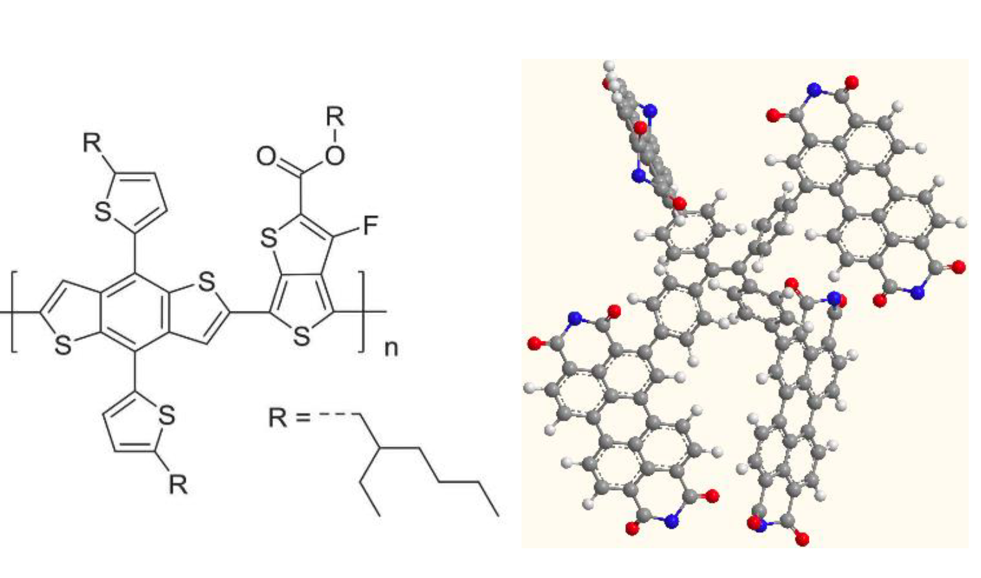
How to Prevent PDI Aggregation
PCE = 5.5%

Slide 7
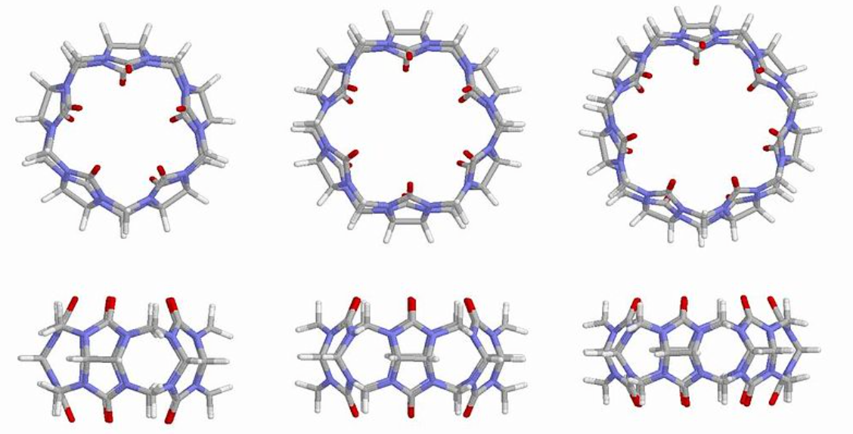
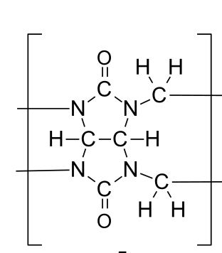
Cucurbiturils
CB[5]
CB[6]
CB[7]

Slide 8
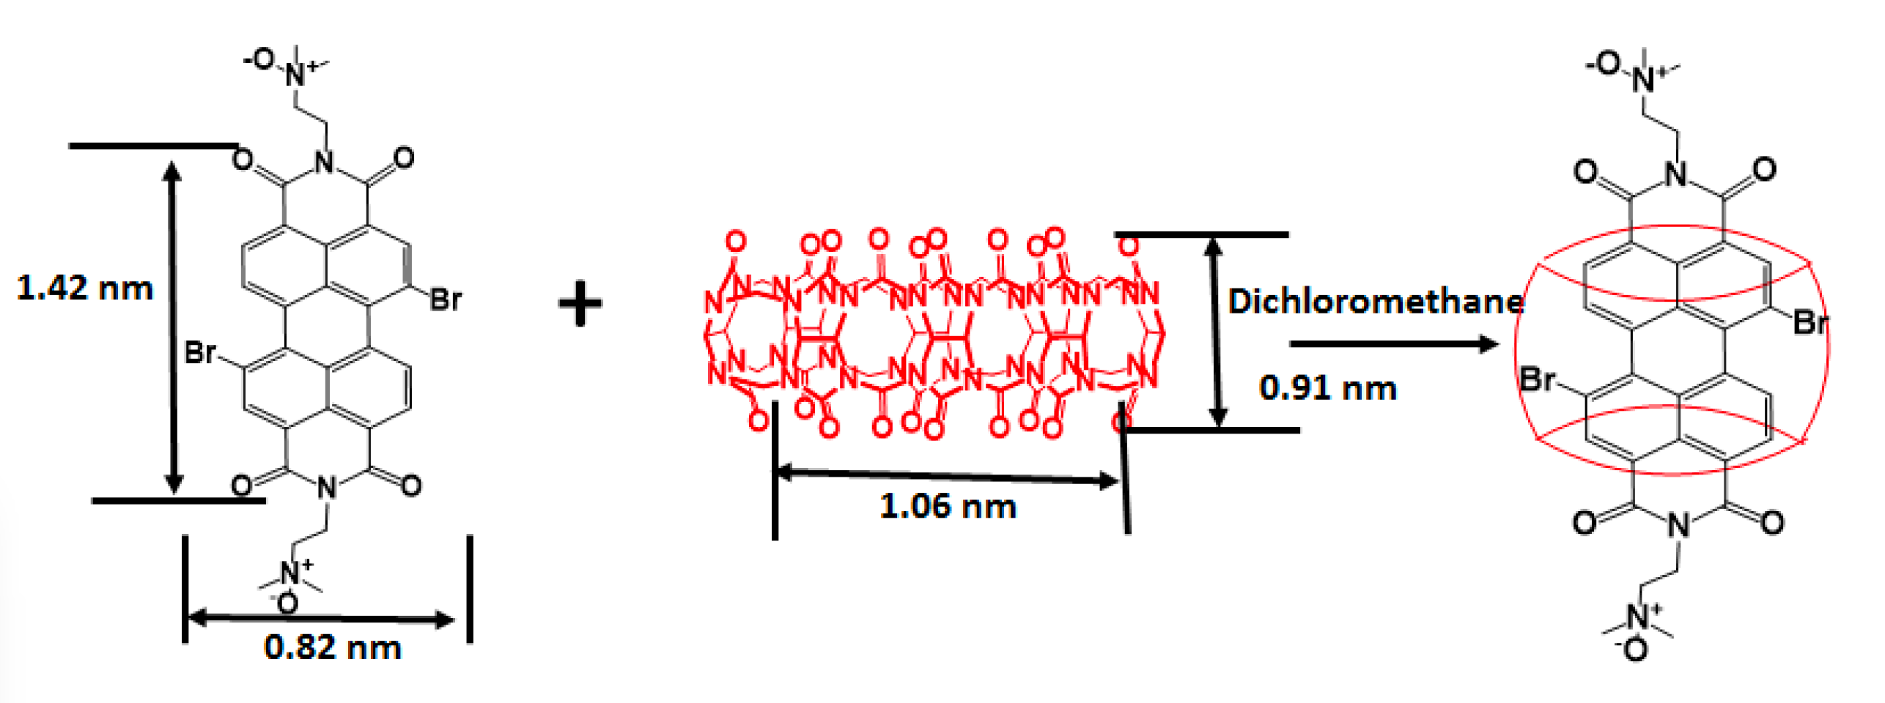
Use CB[10] to Prevent PDI Aggregation

Slide 9
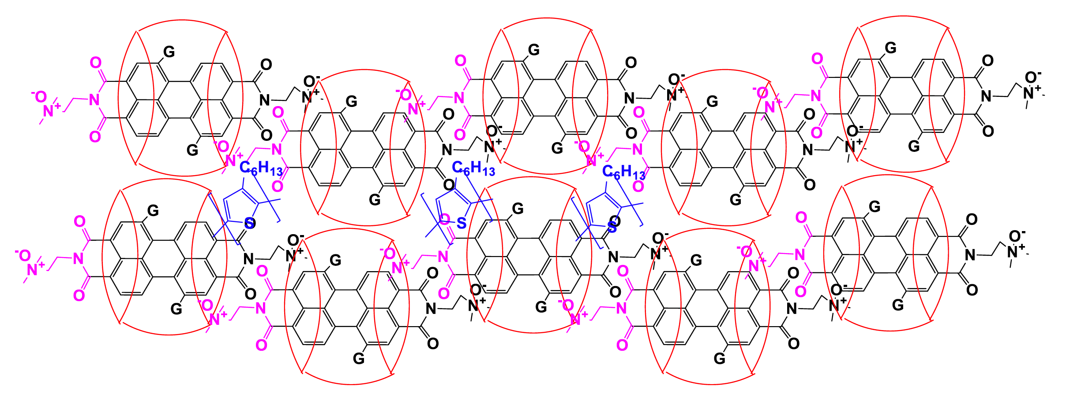
Ideal Crystalline Structure of Photoactive Layer

Slide 10
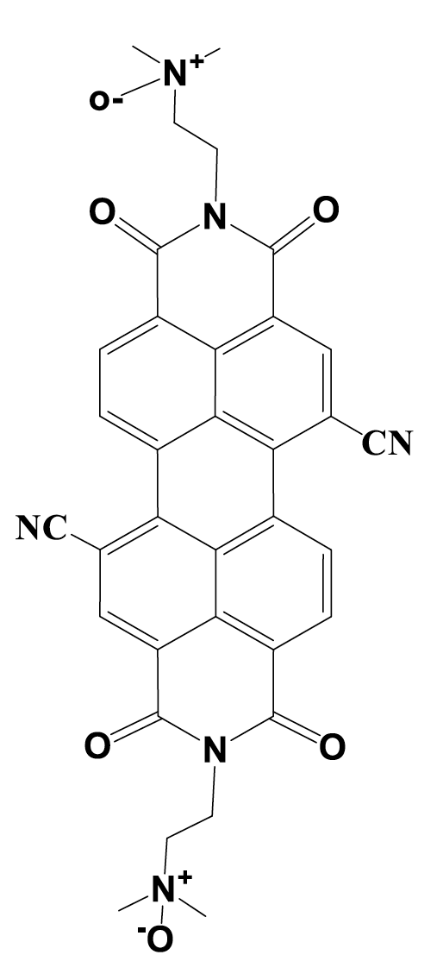
Effect of Substitution
 | E_{ex} | λ_{ex} | HOMO | LUMO
PDI | 2.7066 | 458.1 | -0.284 | -0.081
PDI-Br | 2.7144 | 456.8 | -0.291 | -0.085
PDI-CN | 2.7003 | 459.2 | -0.301 | -0.097
PDI-OH | 2.6035 | 476.3 | -0.275 | -0.077
PDI-NH₂ | 2.3570 | 526.1 | -0.260 | -0.071

Slide 11
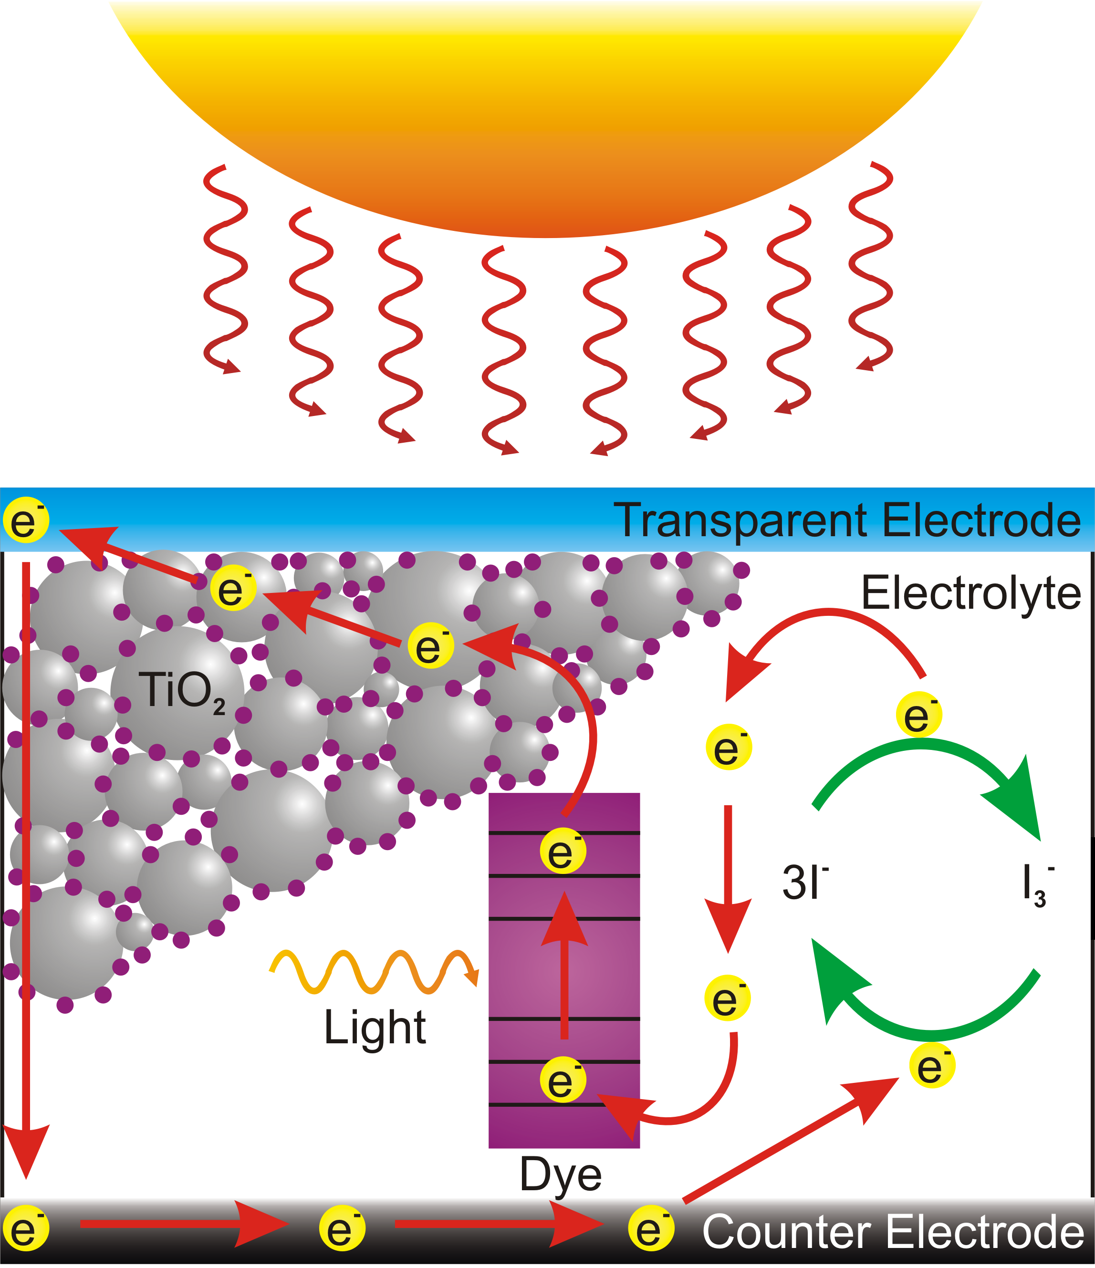
Dye-Sensitized Solar Cells

Slide 12
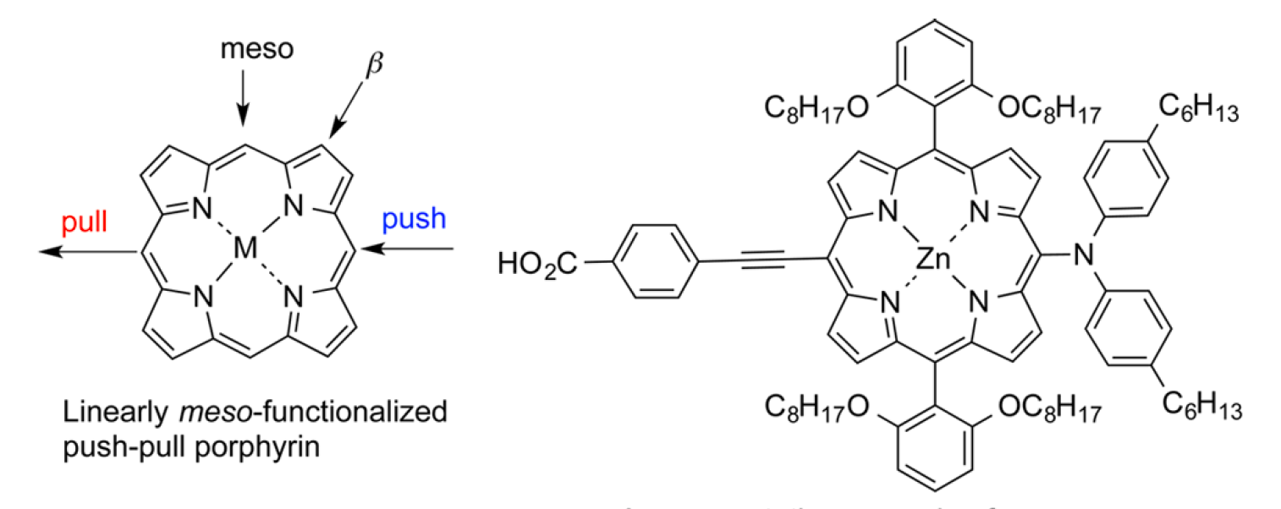
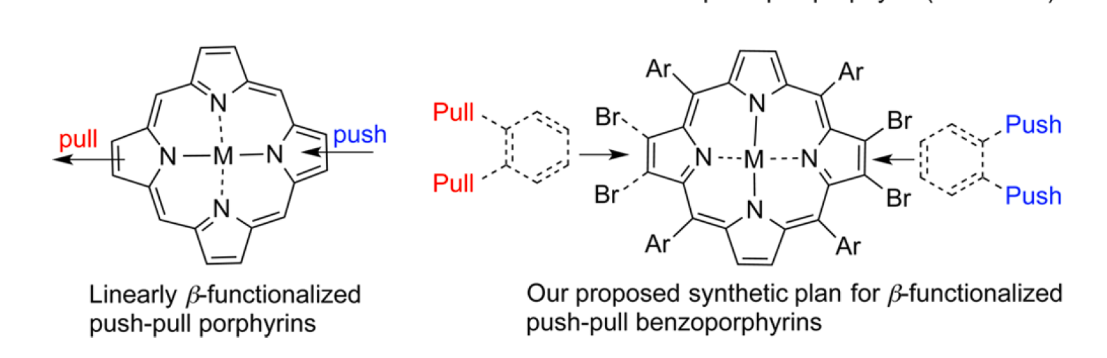
Functionalized Push-Pull Porphyrins

Slide 13
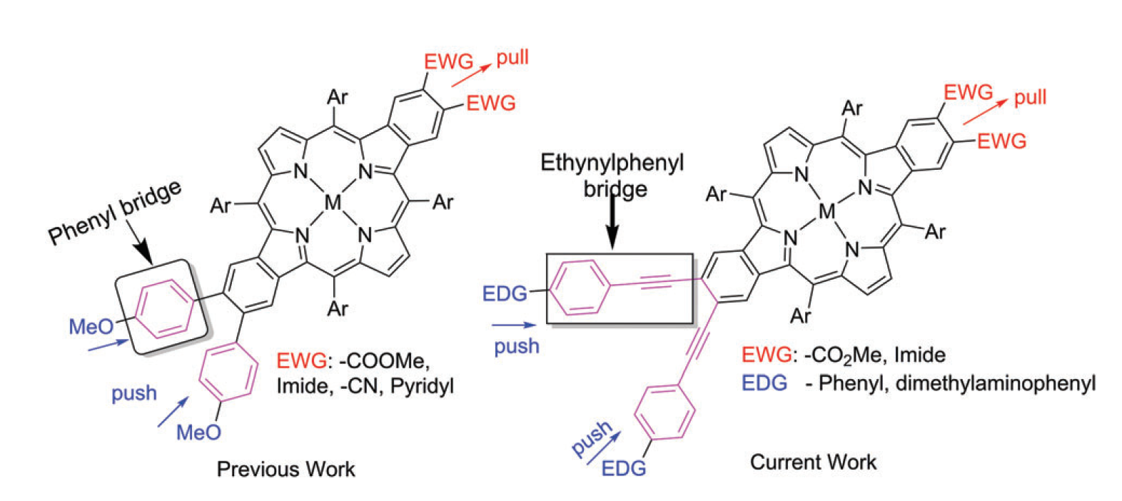
β-Functionalized Porphyrins
Hong Wang et al, JOC, 80, 12076 (2015); PCCP, 19, 13182 (2017).

Slide 14
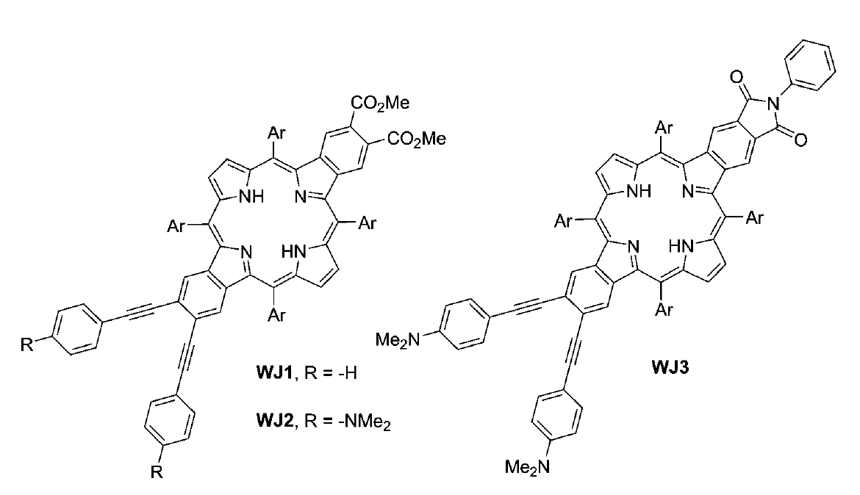
Functionalized Dibenzoporphyrins

Slide 15
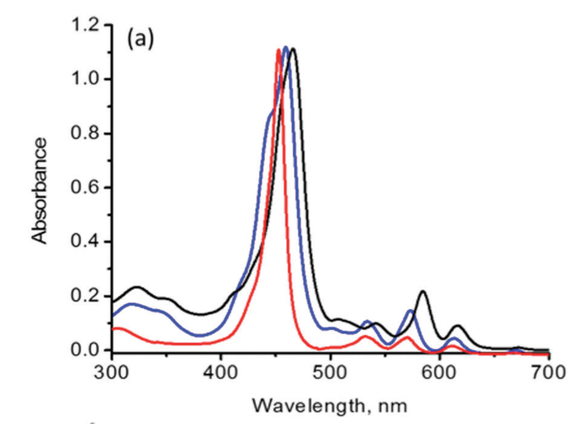
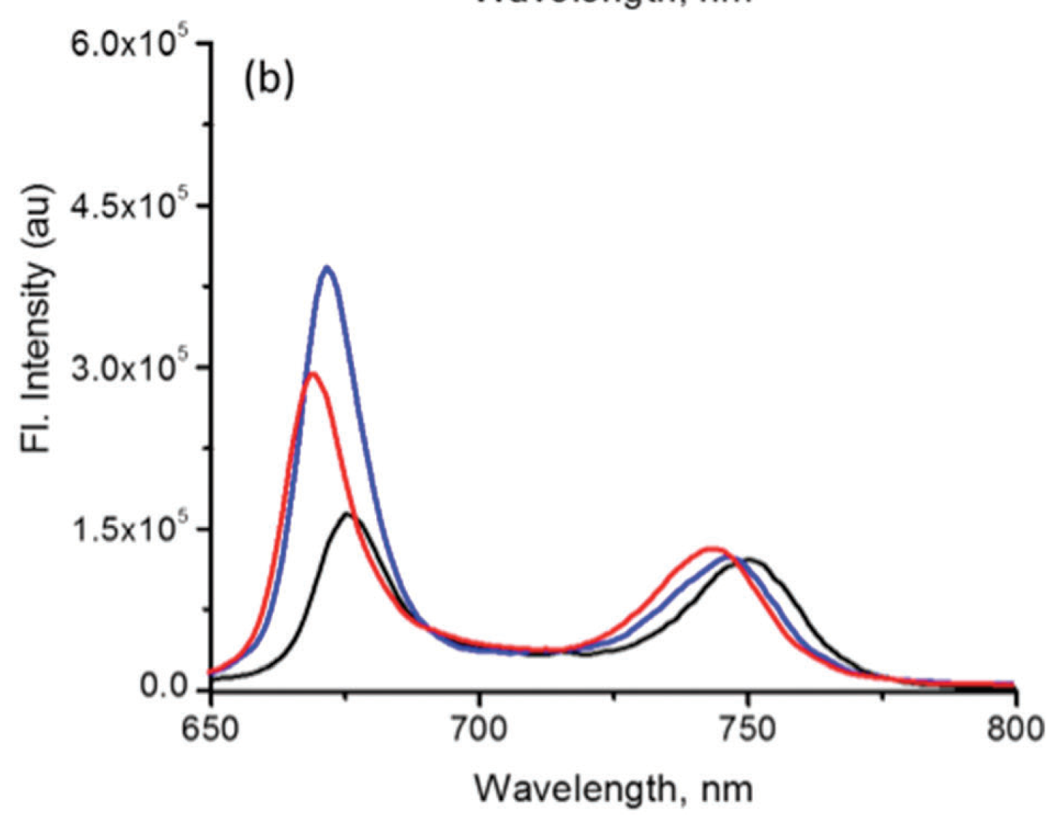
Absorbance/Fluorescence Spectra

Slide 16
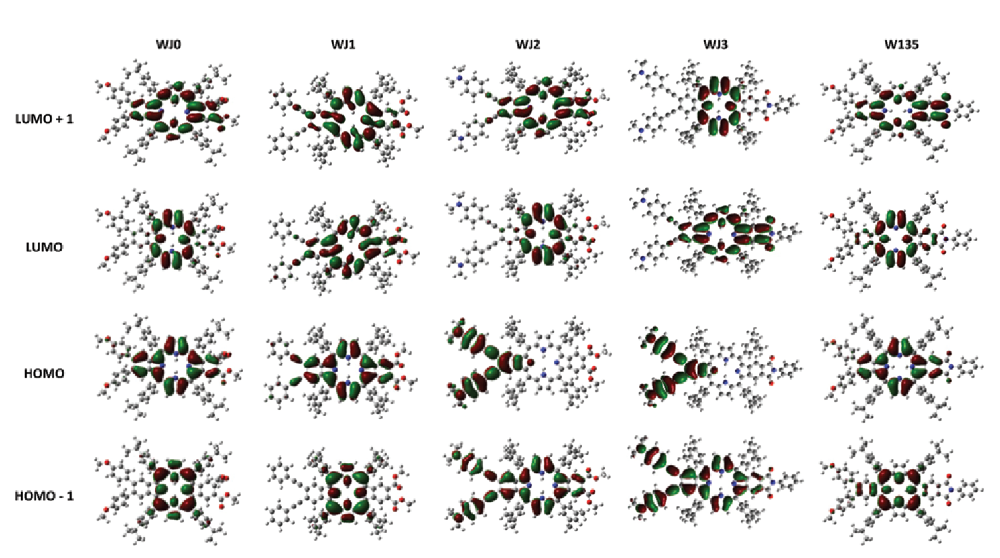
Molecular Orbitals

